Slide 1
Advanced Search for ISLG Portal using ML and Elastic Search
Dhrumil Shah
(Project Lead)

Slide 2
Points for discussions
Problem Statement
Scope of the PoC
Current Status of the PoC
List of Completed Activities
Remaining Activities
Proposed Architecture
  Online option
  Offline option
Progress after our Last Call
Some Screen Shots of Search Prototype
Next Deliverable
Potential next steps
Q & A

Slide 3
Problem Statement
Identify the strengths and weaknesses of Contegra and Microsoft ML platforms.
Develop sample machine learning models that work on sample data. Build a machine learning database and develop a proof-of-concept Search feature for demonstration.
The machine learning models would derive their inputs from existing subject-matter expert (SME) data contained in ISLG (e.g., Subject Navigator, Article Citator, Jurisprudence Citator and Publication Citator)
Completed
In
Progress
Next
Phase

Slide 4
Scope of PoC
Study Contegra Auto search Functionality
Implement Contegra Auto Search into current ISLG portal
Study Azure ML Studio and explore potential use for Text Mining, NLP and other features in the ISLG context
Devise a solution for Search functionality in terms of Flexibility and Efficiency
Implement the Solution for demonstration

Slide 5
Current status of the PoC
Successfully completed R&D on Azure ML platform. We are now getting the desired results
Successfully completed R&D on Elastic Search. We have achieved the Search performance as per expectation
Successfully created API to Call the Elastic Search Database using Node.js
Currently working on automation to connect all the individual tasks into a comprehensive production-grade package

Slide 6
List of Completed Activities
On Azure ML :
  Manual extraction of text from the PDF which is then provided as input to the Azure ML Studio in the form of a ‘CSV’ File
  Pre-process Text (Cleaning the Data; remove the Grammar, etc. from the text)
  Extract N-Gram (Extract Phrases and Words from the Text)
  Apply Two-Class Bayes Point Machine Algorithm (This produces the CSV file or Dataset which will be stored as a Blob on Azure Storage)

Slide 7
List of Completed Activities
On Elastic Search
  Installation and setup of Elastic Search and Kibana
  Manual uploaded of the output file from the Azure ML Studio into Elastic Search as an input data
  Created the index on Elastic Search
  Created API using Node.js which fetches the data from Elastic Search using Fuzzy Logic
  Created a Demo Web Application where this API is integrated for consuming the Elastic Search result set

Slide 8
Remaining activities
Create Azure Function which will always watch the blob storage on Azure and whenever a new file is inserted by the Azure ML Studio process, it will migrate all the data automatically into Elastic Search.
Need to automate the functionality which will automatically trigger the Azure Function API whenever a new PDF or HTML has been uploaded on the source file server
Need to setup the Demo access for Tologix for review and feedback.
Need to move the complete apparatus to Azure Environment; right now all development items are local at DEV IT except the Azure ML piece.

Slide 9
Proposed Architecture
There are two possibilities to achieve our problem statement.
Azure based Online Solution
  Elastic Search and its API will be deployed on the Azure Cloud
    Advantage over offline: Elastic Search will be truly ‘elastic’ because it will use the cloud scalability depending on memory usage and user loads
Offline Solution
  Elastic Search and its API will be deployed on current ISLG hosting
    Advantage over Online: Elastic Search will be reside on the same application server; only one API call needed to get elastic data.
Online Solution is preferable over Offline as the Azure ML is online and the Search performance is always guaranteed because of inherent cloud elasticity.

Slide 10
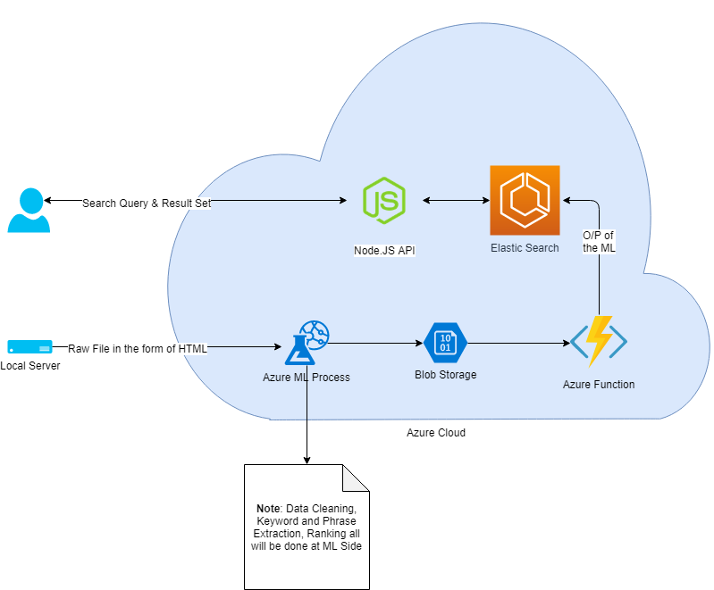
Online Architeture

Slide 11
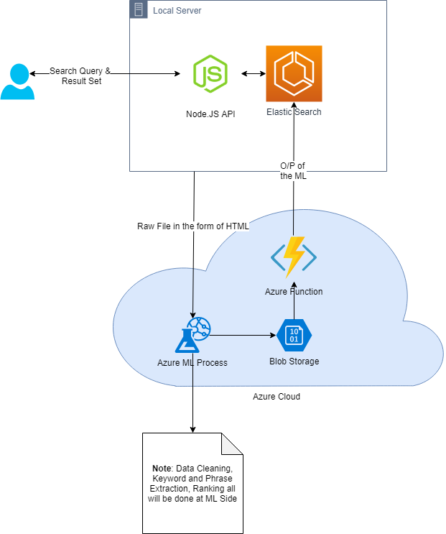
Offline Solution

Slide 12
Progress after our last call
Designed the Architecture for the Solution
We have manually extracted text from 4000+ PDFs and imported into the Azure ML Studio, verified the output from the Elastic Search in terms of Response times, Reliability, Quality of the Suggestion and Accuracy.
We have tried to automate the manual process of the import data into Elastic using “Logstash” but then decided to discard this approach due to certain technical limitations
Currently we are implementing the Azure function which lists the items on Azure blob storage and automatically import data

Slide 13
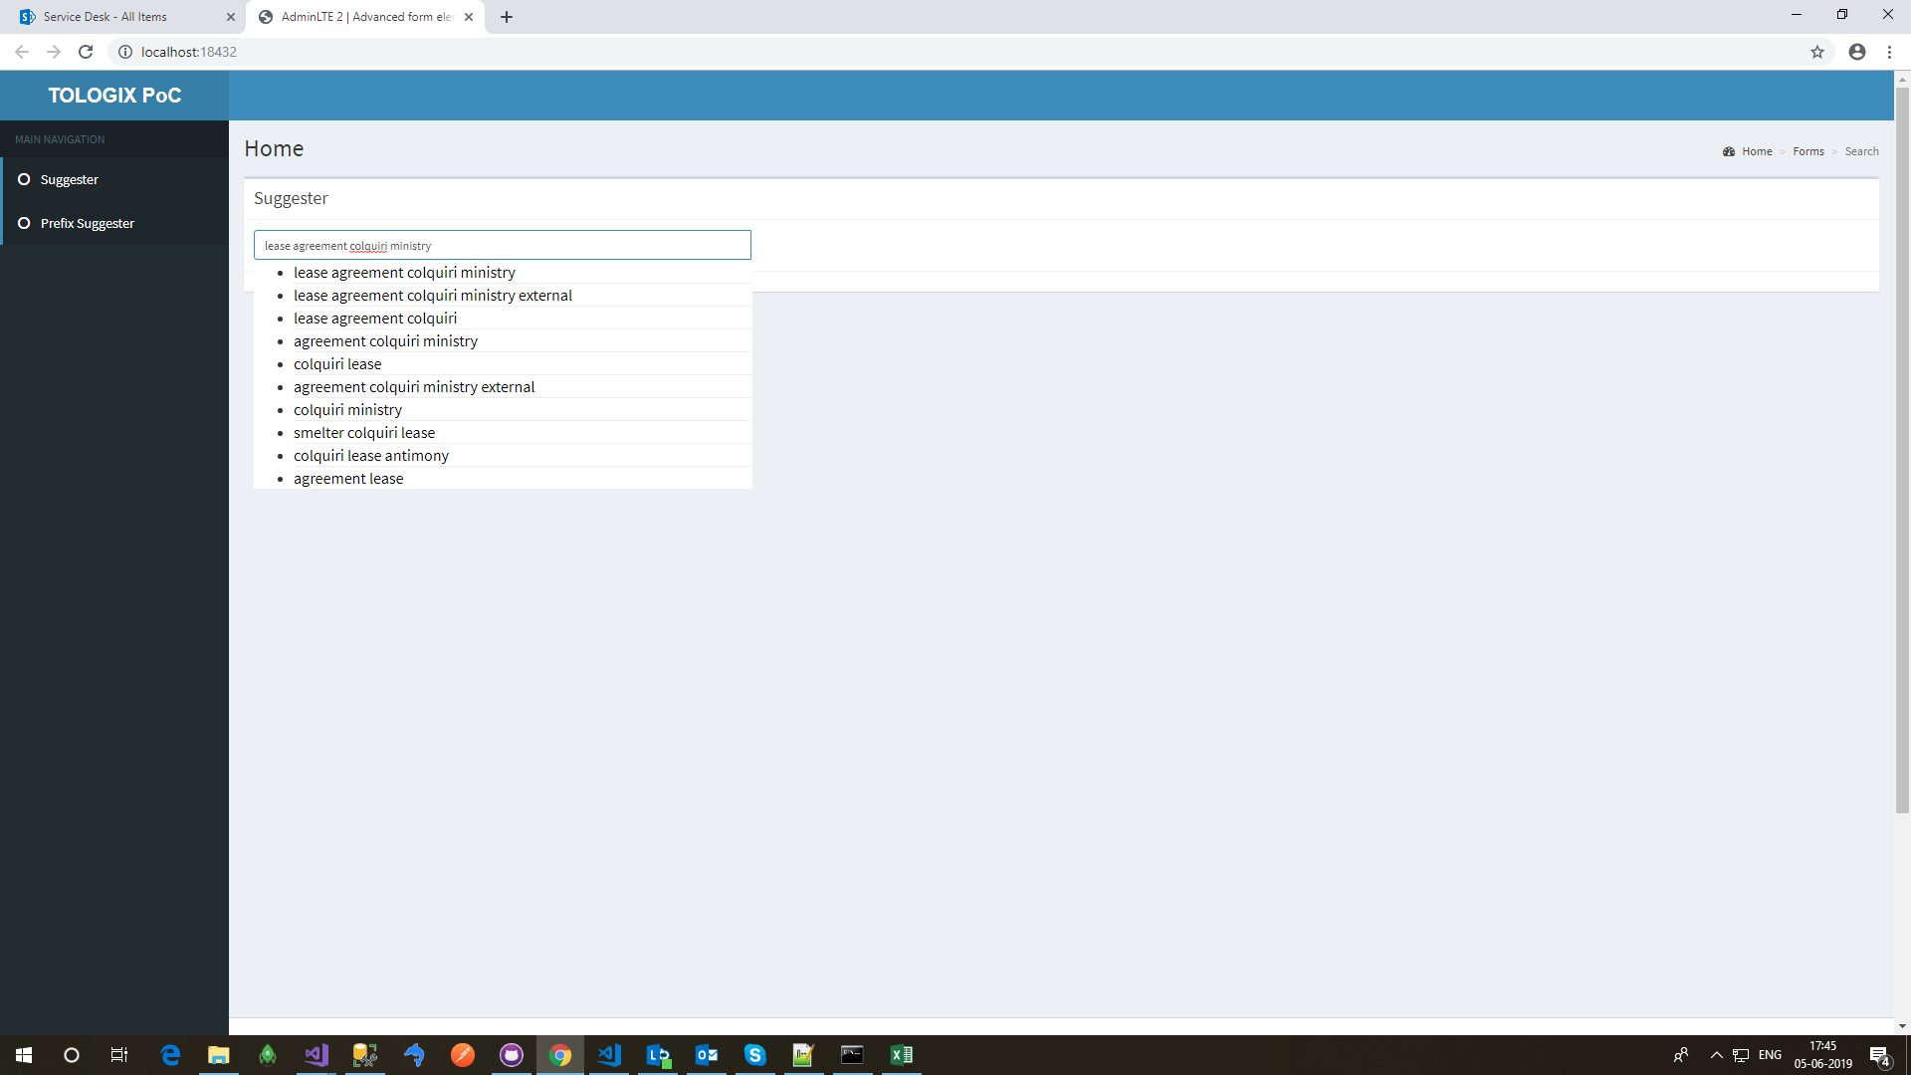
Some screen shots of the Search prototype

Slide 14

Some screen shots of the Search prototype

Slide 15

Some screen shots of the Search prototype

Slide 16
Next deliverable
We will create a Demo application which can be accessed by Tologix team to test, review and provide feedback. We will use about 30 PDF files and provide you the extracted Keywords and Phrases list in an Excel sheet. This will help you to conduct comprehensive Search tests and compare the search results for relevance, accuracy, etc.
Meanwhile we will commence working to automate all manual activities
Once done we will deploy a fresh demo on Azure Cloud

Slide 17
Potential next steps
Categorize and classify the Phrases and keywords by Subject Matter Expert further enhancing the Search algorithm and producing more accurate and relevant results
Monitor, Track and Maintain history of User searches. Develop an extension of the algorithm to deliver user-focused search results based on past history and determining areas of interest
Extend the solution to eliminate the need for “dt_search”

Slide 18

Q & A ?

